Slide 1
CENTERSTONE SCHOOL-BASED CLINICAL TRAINING SERIES
Eleos
Putting It Into Practice
June 2026

Slide 2
CENTERSTONE CLINICAL TRAINING SERIES
TRAINING SERIES
Welcome to Today's Training
Putting It Into Practice
In this session we will focus on how Eleos functions as a note-taker — not a note-writer — and how using it intentionally during sessions allows you to complete 90–100% of your documentation before the client leaves the room.
Eleos Training
Objectives — By the end of this training you will be able to:
01
Explain what Eleos captures and what it does not.
This training includes hands-on practice time, small group activities, and a live walkthrough of Eleos as a session tool.
02
Log in to Eleos and confirm it is working in Avatar TN NX Live.
03
Set up Eleos Mobile using the InTune Company Portal.
04
Start and stop Eleos smoothly within a clinical session.
05
Map Eleos outputs to your note template and complete documentation in session with your client.
SESSION FORMAT
Hands-on practice & small groups included throughout today's session.

Slide 3
“
Why This Training Matters
Documentation should not follow you home. When Eleos is used as a note-taker during the session — not a task to complete afterward — therapists finish the day with their notes done, their clients more engaged, and their admin burden reduced.
This training is about building a natural, confident workflow: starting Eleos before the first clinical question, letting it capture the session, and spending the final minutes of the appointment mapping outputs to the note template — together with the client.
”
Less time on paperwork. More time on what matters.

Slide 4
TRAINING PURPOSE
ELEOS CLINICAL TRAINING SERIES
01
02
03
04
05
Confirm Access
Practice Safely
Set Up Mobile
Build Your Flow
Map to Your Note
Ensure Eleos is working in Avatar: TN NX Live before your first session.
Use Avatar: TN NX UAT (Testing) to build skills without affecting any live records.
Configure Eleos on your phone using InTune Company Portal. Allow 10–15 minutes.
Develop a natural start/stop rhythm that fits seamlessly into your real sessions.
Translate Eleos outputs directly to the Centerstone note template — in session, with your client.

Slide 5
Eleos Is a Note-Taker. Not a Note-Writer.
Understanding the difference changes how you use it.
Note-TAKER
Note-WRITER
WHAT ELEOS ACTUALLY IS
WHAT IT IS NOT
Runs in the background while you stay present.
It does not write your clinical note for you.
Captures key moments, interventions, and client quotes.
It cannot assess risk or make clinical judgments.
Generates a draft you shape — not a finished product.
It does not capture sarcasm, coded language, or nonverbal cues.
Keeps you in the room, not in your head.
It does not replace mandated reporting steps.
Allows 90–100% of documentation to be completed before the client leaves.
It cannot track progress toward the identified session objective.
Your job: guide the session. Eleos captures it. You complete the note — together with your client — before they walk out.

Slide 6
ELEOS TRAINING SERIES
01
02
What Eleos Does Well
Capturing key clinical moments from the session
Identifying and labeling interventions used
These are your building blocks — the raw material for a complete note.
03
04
Pulling direct client quotes
Tracking themes across the conversation
05
06
Drafting assessment and plan language
Significantly reducing documentation time when used in session
The goal is a note that is 90–100% complete by the time the client leaves.

Slide 7
Step 1 — Setup & Login
Before anything else, let's make sure you're in.
1
2
3
4
Open Avatar
Open Eleos
Confirm Login
Check Audio Input
Navigate to Avatar TN NX Live in your browser and confirm the application loads correctly.
Launch the Eleos app alongside Avatar so both are visible and ready to use together.
Verify your credentials are accepted. Confirm microphone permissions and notifications are enabled.
Confirm your device is picking up sound correctly before any session begins.
We will pause here — take a few minutes to log in now. Do not move forward until you are in.

Slide 8
CENTERSTONE CLINICAL TRAINING SERIES
Is Everyone Logged In?
Everything Working So Far?
Take a moment. Check your login. Confirm your microphone. If anything is not working — raise your hand now.
Do not move forward with a broken setup. We fix it here.

Slide 9
Setting Up Eleos Mobile
InTune Company Portal Setup — Allow 10 to 15 Minutes
Complete the 30-minute Relias training prior to using Eleos in live sessions: centerstonetn.training.reliaslearning.com — Course Code 1600000454
1
Download InTune Company Portal from your app store.
7
From your home screen open Settings → Profile Downloaded.
2
Sign in using your Centerstone credentials.
8
Tap Install (upper right) — enter your passcode when prompted.
3
When prompted, select Allow for notifications.
9
Select Trust when prompted about remote management.
4
Follow prompts to set up Centerstone access — select Allow for profile configuration when asked.
10
Select Done — then launch Company Portal and tap Install.
11
Make any prompted changes — select Done when complete.
5
Select Close then Continue to keep setting up access.
6
Follow the prompts to install the management profile.
From your phone browser (Edge recommended) — create a quick-access shortcut to Eleos on your home screen.

Slide 10
Hands-On Practice — Test Avatar
Small Group Activity — Allow 10 to 15 Minutes
10–15
MINUTES
SMALL GROUPS
TEST AVATAR ONLY
Dedicated practice time in small groups
If more than 2 people, split into breakouts
Use Avatar TN NX UAT — no live records affected
WHAT TO DO
WHAT TO CONFIRM
Open Avatar NX test environment
You have access to the test environment
Start Eleos and add activity information
Eleos starts and stops without issue
Have a 10-minute practice conversation
You can hear your audio captured
Focus on flow and natural rhythm — not perfection
You know how to add session activity information
This is where you build confidence before using Eleos with a real client.

Slide 11
CLINICAL TRAINING SERIES
FOUR KEYS TO A SMOOTH START
Starting Eleos Smoothly
Have it primed and ready to hit start before you arrive with your client.
Eleos should already be running when the session begins. Do not wait until you are deep into conversation.
A clean start sets up a clean note.
Keep your introduction warm and simple
A brief, natural statement to your client: "I use a tool that helps me stay focused on you instead of taking notes."
Start. Every. Session.
Consistency is the only way to build the habit.
It is okay if you forget to start
Eleos captures from the moment you press start — not from the beginning of the session. If you forget, start when you notice.
Start before the first clinical question
Warm, simple client introduction
Every client. Every session.
Time permitting — we will practice what this opening sounds like across different client types.

Slide 12
What To Do When You Miss the Start
Start when you notice
It does not matter if you are already five or ten minutes in. Press start. Eleos begins capturing right there — including the walk down the hallway.
Acknowledge the gap out loud
When you get to your office, simply say what Eleos missed — or note there is nothing significant to add. You are in control of the context.
Use the catch-up tactic
Flexibility Is the Point
Recap what happened before you started by weaving it naturally into what comes next. You do not need to stop the session — just speak it forward.
Example — say this out loud in session
"Okay — now that we have done highs and lows, since you said you have been feeling bad about yourself, how about we play this game so you can teach me about some of your favorite parts about being you."
That one sentence tells Eleos what happened before it started and opens the next intervention at the same time.
Eleos captures from the moment you press start. A late start is not a failed start. Begin where you are.
Start. Catch up. Keep going. Eleos works with your session — not against it.

Slide 13
Stopping Eleos — and Finishing the Note Before They Leave
This is the whole point. The note gets done in the room.
STEP 1
7 to 10 Minutes Before Session Ends
Stop Eleos. Use a natural closing line. Begin transitioning the session toward closure.
1
STEP 2
Review Eleos Outputs Together
Briefly review what Eleos captured — Key Moments, Interventions, Assessment, Plan language. Use this moment with the client to validate accuracy and reinforce the work.
2
STEP 3
Map to Your Note Template
Your note format:
Session Objective ·
Progress ·
Life Occurrences ·
Intervention and Client Response ·
Obstacles
Plan
Fill in what Eleos gives you. Add your clinical layer.
3
STEP 4
Complete Before Client Leaves
The goal is 90–100% of the note done in session. What remains is a final clinical read — not a writing task you carry home.
4
Documentation is part of the clinical act — not the tax on it.

Slide 14
When Things Do Not Go as Planned
TROUBLESHOOTING — ELEOS
Eleos Is Not Capturing Audio
App Froze or Crashed
Login Is Not Working
Check that your microphone is enabled in your device settings. Close and reopen the Eleos app. Confirm no other app is using the microphone.
Close the app completely and reopen it. If a session was in progress, Eleos may have saved a partial capture — check before starting over.
Confirm you are using your Centerstone credentials. Check your internet or Wi-Fi connection. Try closing Avatar and Eleos, then reopening both.
Note Output Is Incomplete or Missing
Mobile App Not Functioning
Still Having Issues?
Confirm the session was stopped — not just paused. If the capture was very short, output may be limited. Check the Eleos session log for what was recorded.
Confirm InTune Company Portal setup is complete. Re-install the app if needed. Check that Centerstone credentials are linked to your mobile profile.
Talk it through with your team lead first. If the issue is technical and unresolved, contact Eleos support — at the end of your day, never in the middle of a session.
Do not troubleshoot during a session. Finish with your client. Address it after.
Eleos Support is available for technical issues your team lead cannot resolve. Reach out at day's end.

Slide 15
Mapping Eleos Outputs to Your Note Template
ELEOS OUTPUT
YOUR NOTE TEMPLATE
Eleos Gives You
Your Note Needs
Key Moments — Clinically significant exchanges captured automatically
Session Objective — The identified goal guiding this session
Progress Toward Objective — Client's movement and engagement
Interventions — Identified and labeled from session content
Life Occurrences — Contextual events affecting the client
Assessment — Speaks to mood/affect and general progres
Intervention & Client Response — What was done and how client responded
Plan — Next steps and treatment direction
Obstacles -- What were barriers in the session?
Assessment & Plan — Clinical summary and next steps
MAPS TO
Eleos provides the raw material. Your clinical judgment shapes the note. Do it in session — with the client present — and you leave with nothing left to write.

Slide 16
You now have what you need to use Eleos with confidence.
Log in before every session. Start before the first clinical question.
Stop 7–10 minutes early. Complete the note in the room.
Use the test environment to keep your skills sharp.
Eleos does not make you a faster note-writer. It makes documentation part of the session — so nothing follows you home.
Centerstone School-Based Clinical Training Series

Slide 17
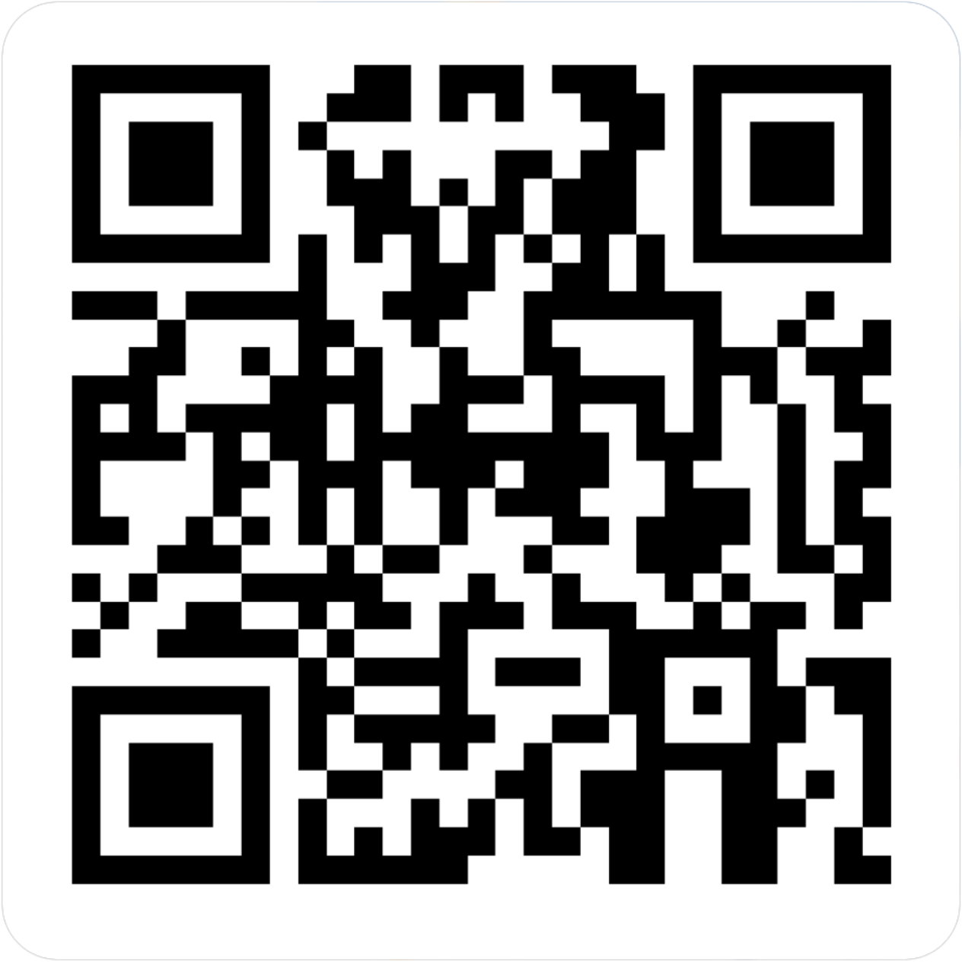
CENTERSTONE SCHOOL-BASED CLINICAL TRAINING SERIES
Eleos: Putting it into Practice
Completion of this survey is required for attendance verification for today’s training.
https://forms.office.com/r/EXVCQtPbti

